Slide 1
Procedure of VM Spawn
-IRSHAD

Slide 2
Agenda
VM Call Flow
VM Life Cycle

Slide 3
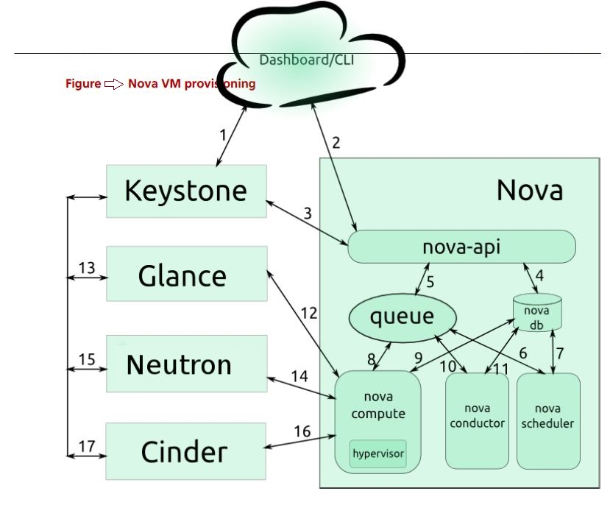
(1)
Dashboard/CLI → Keystone
The dashboard or CLI gets the user credentials and authenticates with the Identity Service via REST API.
The Identity Service authenticates the user with the user credentials, and then generates and sends back an auth-token which will be used for sending the request to other components through REST-call.

Slide 4
(2)
Dashboard/CLI → nova-api
The dashboard or CLI converts the new instance request specified in launch instance or nova-boot form to a REST API request and sends it to nova-api.

Slide 5
(3)
Keystone → nova-api
nova-api receives the request and sends a request to the Identity Service for validation of the auth-token and access permission.
The Identity Service validates the token and sends updated authentication headers with roles and permissions.

Slide 6
(4)
nova-api → nova db
nova-api creates initial database entry for a new instance.

Slide 7
(5 & 6)
nova-api → queue → nova scheduler
nova-api sends the rpc.call request to nova-scheduler expecting to get updated instance entry with host ID specified.
nova-scheduler picks up the request from the queue.

Slide 8
(7 & 8)
nova-db → nova-scheduler →queue →nova-compute
nova-scheduler interacts with nova-database to find an appropriate host. nova-scheduler sends the rpc.cast request to nova-compute for launching an instance on the appropriate host.

Slide 9
(9, 10, & 11)
nova-compute → nova-conductor
nova-compute sends the rpc.call request to nova-conductor to fetch the instance information such as host ID and flavor (RAM, CPU, Disk).
nova-conductor picks up the request from the queue.
nova-conductor interacts with nova-database. nova-conductor returns the instance information. nova-compute picks up the instance information from the queue.

Slide 10
(12)
nova-compute → Glance
nova-compute performs the REST call by passing the auth-token to glance-api. Then, nova-compute uses the Image ID to retrieve the Image URI from the Image Service, and loads the image from the image storage.

Slide 11
(13)
Glance → Keystone
glance-api validates the auth-token with keystone. nova-compute gets the image metadata.

Slide 12
(14)
nova-compute → Neutron
nova-compute performs the REST-call by passing the auth-token to Network API to allocate and configure the network so that the instance gets the IP address.

Slide 13
(15)
Neutron → Keystone
neutron-server validates the auth-token with keystone. nova-compute retrieves the network info.

Slide 14
(16)
nova-compute → Cinder
nova-compute performs the REST call by passing the auth-token to Volume API to attach volumes to the instance.

Slide 15
(17)
Cinder → Keystone
cinder-api validates the auth-token with keystone. nova-compute retrieves the block storage info.

Slide 16
nova-compute → libvirt
nova-compute generates data for the hypervisor driver and executes the request on the hypervisor (via libvirt or API).

Slide 17
Life Cycle
The life cycle of a typical virtual system within an OpenStack cloud:
1. Initial State
2. Launching an instance
3. End State

Slide 18
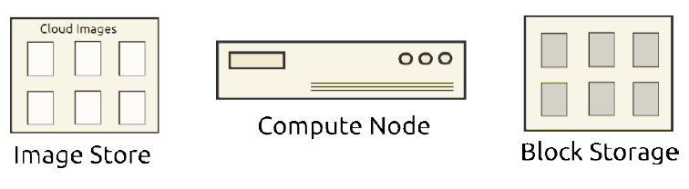
1. Initial State:
The following diagram shows the system state prior to launching an instance
Fig: Initial State

Slide 19
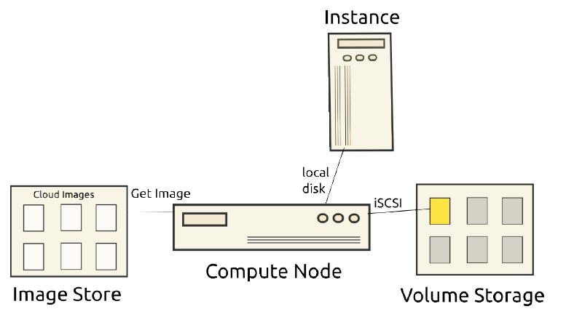
2. Launching an instance:
The user selects an image, a flavor, and other optional attributes.
The OpenStack system copies the base image from the image store to local disk which is used as the first disk of the instance(vda).
The instance is booted from the first drive. The instance runs and changes data on the disks highlighted in yellow in the diagram.
Fig: Launch VM Instance

Slide 20
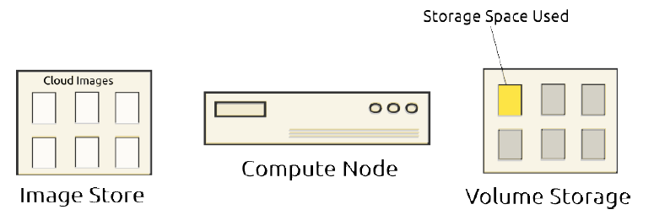
3. End State:
Once the instance has served its purpose and is deleted, all state is reclaimed, except the persistent volume.
The ephemeral storage is purged. Memory and vCPU resources are released.
Fig: End State

Slide 21


Thank you.
Headquarters
303 Twin Dolphin Drive 6th Floor Redwood City, CA 94065 USA
Tel: +1 650 632 4310 Fax: +1 650 551 9901
APAC HQ
Plot 31, Electronic City Sector 18 Gurgaon, Haryana 122015 India
Tel: +91 124 4095888 Fax: +91 124 2455100
Europe HQ
Intec 4, Wade Road, Basingstoke, Hampshire RG24 8NE, United Kingdom
Tel: +44 1256 339500

